Slide 1
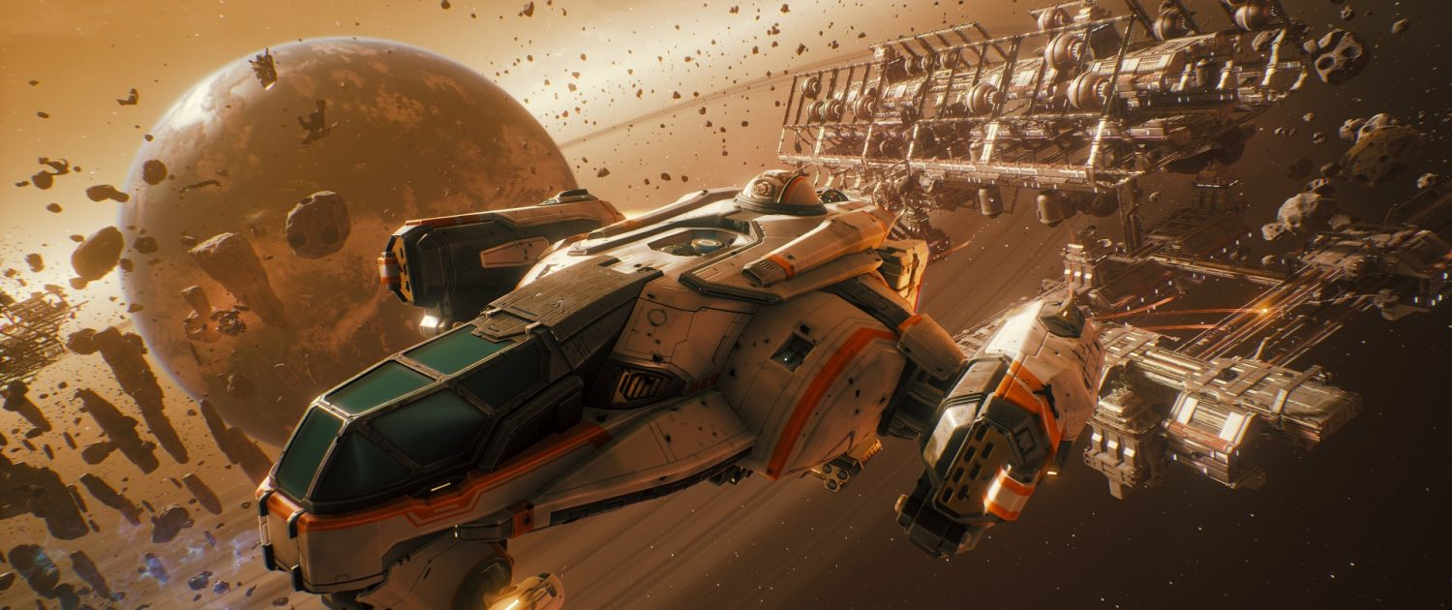

Illusionary World
Lim Jia Lok
Marc Chai

Slide 2
Purpose
Of creating Illusionary World
The purpose of the game is to provide people with a casual, yet challenging experience which they can play to pass the time. This game focuses on an immersive experience which will take the players on a journey of self reflection of their feelings.

Slide 3

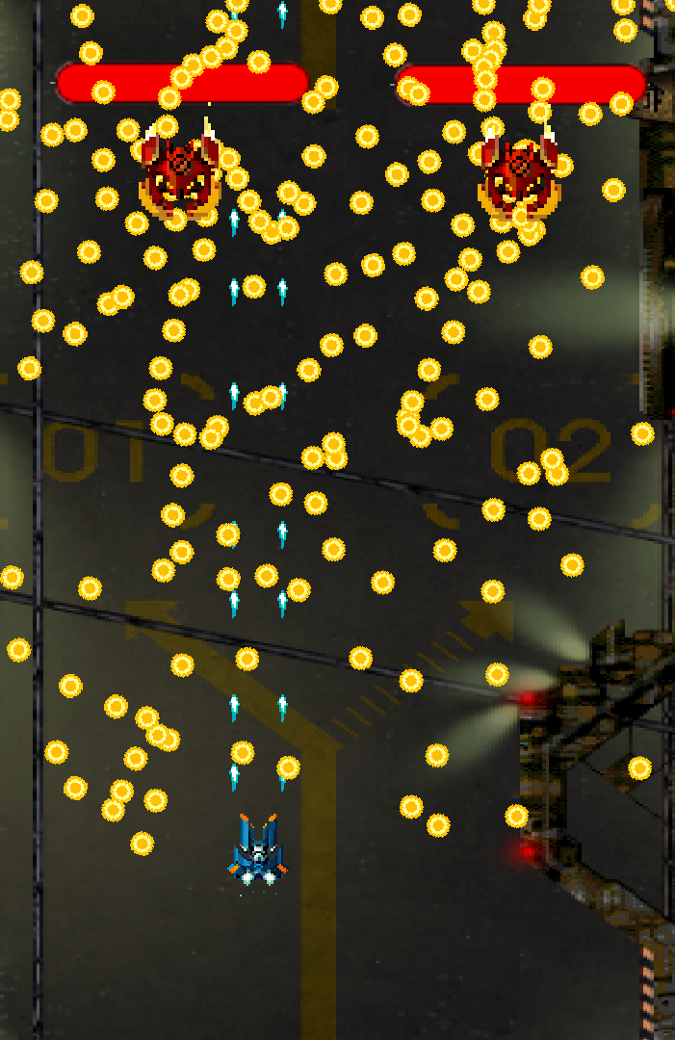
About
Illusionary World
Illusionary World is a bullet hell game based on the 3 human emotions: Denial, Rage and Despair. Each level is a testament to these emotions and the aim is to go through these levels and conquer these emotions no matter what it takes. The game is designed to give the player a sense of hardship but eventually prove that these walls can be overcome. We, as a team, want to show that as long as one perseveres, success can be attained.

Slide 4
How To Play
1
2
Rake up scores
Goals
Finish each level to get the maximum possible score. You will lose score each time you die, so dodge well!
3
Choose your stage
Play the levels
When you press play, you are given 3 choices of levels. Choose one of them and play through it.
Pause Menu
4
Emergency
In case of any emergencies, press ‘Esc’ to pause the game and access the pause menu.
Enjoy the game
Experience
The game is designed to give players an immersive experience, so play away!

Slide 5
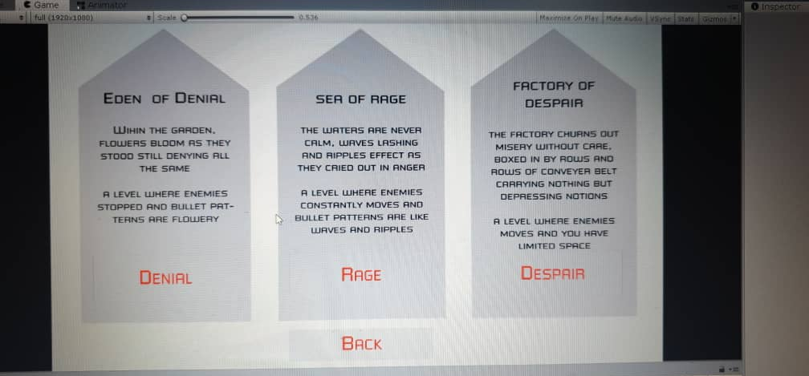
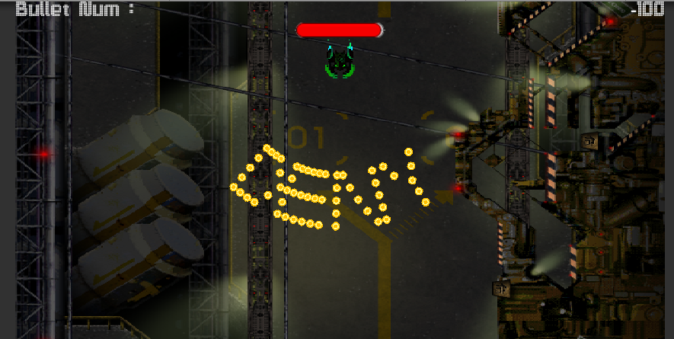
Game Screenshots
Level Selection
Upon pressing play, you are directed to a menu in which you must choose your stage. Choose wisely and conquer thy emotions!
Level
Score
The score system is based on how many times you die and how many enemies you’ve killed. The goal is to die as little times as possible while finishing the level!

Slide 6
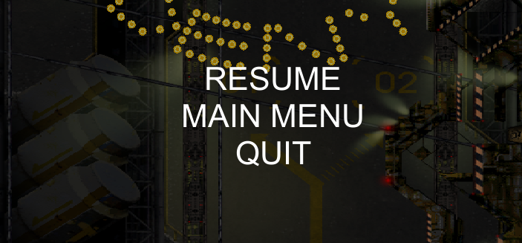
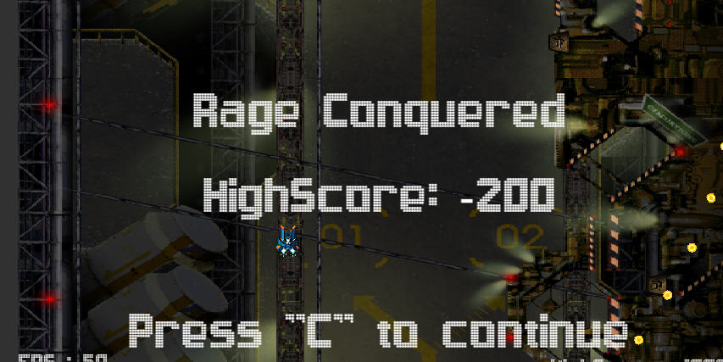
Game Screenshots
Pause
You can pause the game in the heat of the moment to deal with any immediate urgencies. You can also go back to the main menu or quit the game if the level does not suit your tastes.
End Game
Beat the boss in the final wave to complete the level. Your score for the current level will be shown. Do well to flaunt your high score to your friends and family!

Slide 7
Roles
Lim Jia Lok
Marc Chai
UI Designer
UI Developer
01
Designs the user interface for the game
01
Develops the basic user interface framework for the game
Game Director
Game Programmer
02
Designs the overall flow and idea of the game
02
Programs necessary extensions into the game
Project Leader
Producer
03
Oversees the project development and makes goals and deadlines for the team
03
Oversees the team and schedules to make sure the project is delivered on time

Slide 8
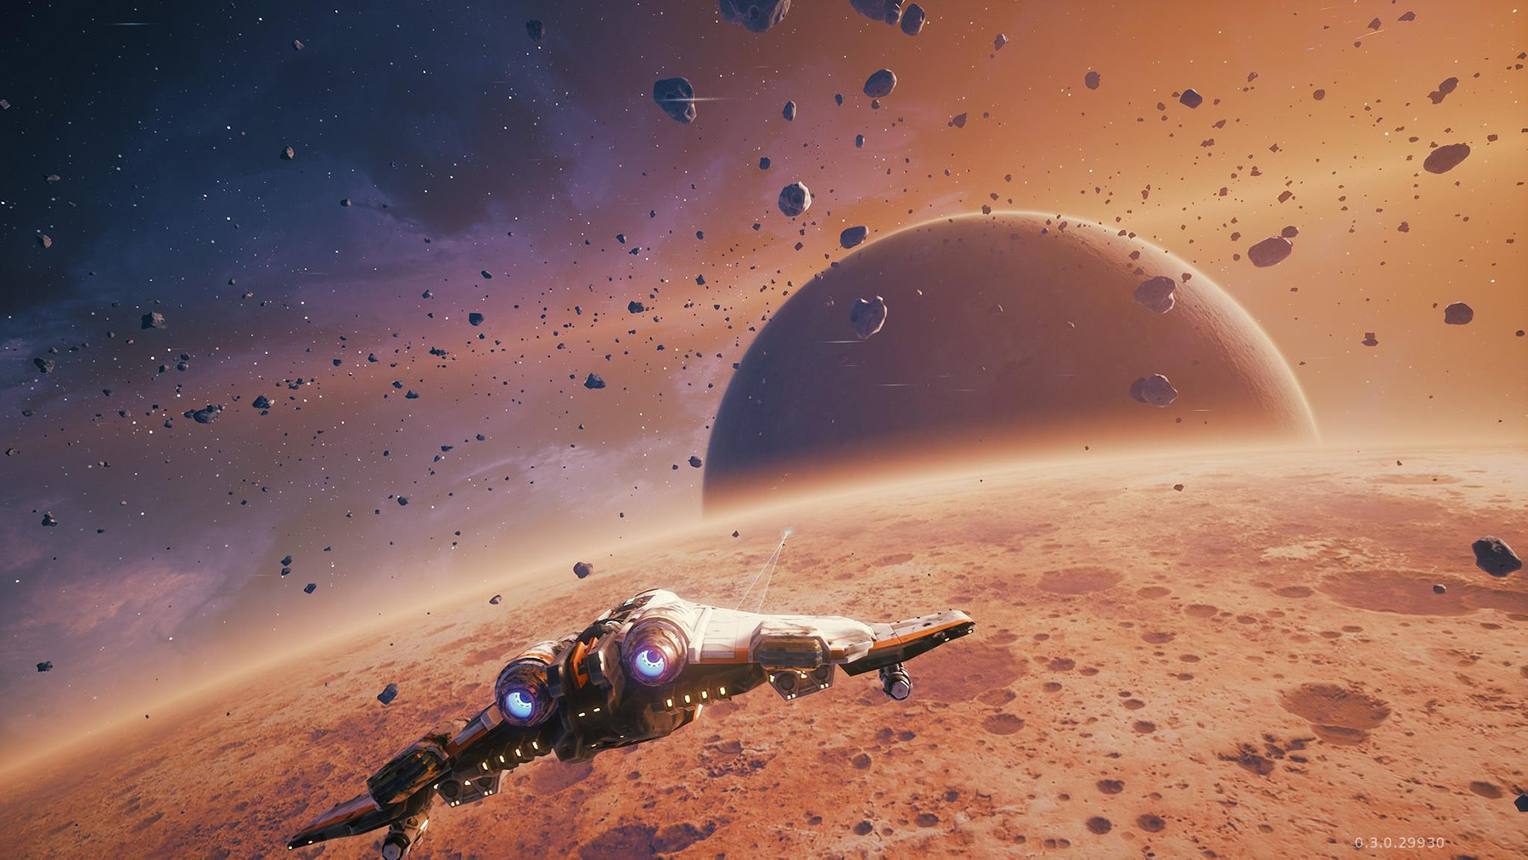
The End
Thank you

